Slide 1
Welcome to the NASA HITSS Program

Slide 2
03/ Welcome to NASA HITSS!
04/ Our Client
13/ Our Program
19/ Our Team
27/ Resources You Can Use
33/ Success Stories 36/ Acronyms

Slide 3
Welcome!
Welcome to the NASA HITSS Program.
We are proud that you have joined us to serve NASA’s Information Technology and Communications Division (ITCD) through the NASA Headquarters Information Technology Support Services (HITSS) program. We are committed to a high performance standard built on teamwork, communication, strong skills, and excellent service.
We are excited to have you as part of the team and are glad to add your strengths and capabilities to our program.
Once again, welcome to Team DMI and welcome to HITSS!
Sincerely,
Greg Summer
DMI HITSS Program Manager

Slide 4
Our Client: NASA ITCD

Slide 5
NASA Client | Who do we serve?
Federal Agency: National Aeronautics and Space Administration (NASA)
Website: http://www.nasa.gov/
Vision: To reach for new heights and reveal the unknown so that what we do and learn will benefit all humankind.
NASA conducts its work in four principal organizations, called mission directorates:
Aeronautics: manages research focused on meeting global demand for air mobility in ways that are more environmentally friendly and sustainable, while also embracing revolutionary technology from outside aviation.
Human Exploration and Operations: focuses on International Space Station operations, development of commercial spaceflight capabilities and human exploration beyond low-Earth orbit.
Science: explores the Earth, solar system and universe beyond; charts the best route of discovery; and reaps the benefits of Earth and space exploration for society.
Space Technology: rapidly develops, innovates, demonstrates, and infuses revolutionary, high-payoff technologies that enable NASA's future missions while providing economic benefit to the nation.

Slide 6
NASA Client | Who do we serve?
NASA Headquarters Information Technology and Communications Division (ITCD)
Mission: The ITCD provides a full range of information technology (IT) and communications products and services to support the programmatic and institutional functions of NASA Headquarters employees and organizations. This includes:
Provisioning of all computer, network, telephone, facsimile, video and teleconferencing, and automated information systems;
Manage all IT services, from IT security, delivery of electronic mail, and interactive Internet communications to the distribution of science and engineering data; and
Printing, duplication, graphics design, exhibit design, and document services.
Website: http://www.hq.nasa.gov/office/itcd/about.html#info
ITCD is composed of the following branches:
Customer Services Branch
Systems Operations Branch

Slide 7
NASA Client | Who do we serve?
Customer Services Branch
Responsible for timely, efficient, and effective delivery of all aspects of desktop Information Technology (IT) services at NASA Headquarters.
Supports all organizations and employees via a consolidated Enterprise Service Desk (ESD), which includes the processing and resolution of trouble tickets and service requests.
Manages standard computer hardware and software product suites and the testing and implementation of new end user computing products.
Champions a Headquarters-wide customer outreach, communication, and education program and is responsible for the public and internal Headquarters Web sites.
Handles the development, deployment, and maintenance of custom applications and Web site development.

Slide 8
NASA Client | Who do we serve?
Systems Operations Branch
Develops, integrates, maintains, and operates Information Technology (IT) infrastructure systems and services for NASA Headquarters.
Manages IT systems engineering, network and computer room operations, telephone services, cable TV, computer equipment maintenance and inventory program, and software license and management programs.
Handles the integration of Agency-based systems and services into the Headquarters computing environment.
Responsible for the Headquarters IT Security program, which includes developing IT policies and procedures and HQ-specific implementations of Federal and agency regulations and instructions.
Manages a full-service Communications Support Services Center (CSSC) that produces professional, high-quality products and offers clear and creative communication strategies. Services include consultation, creative writing and editing, printing, graphic, exhibit, multimedia design, duplication, and document services.

Slide 9
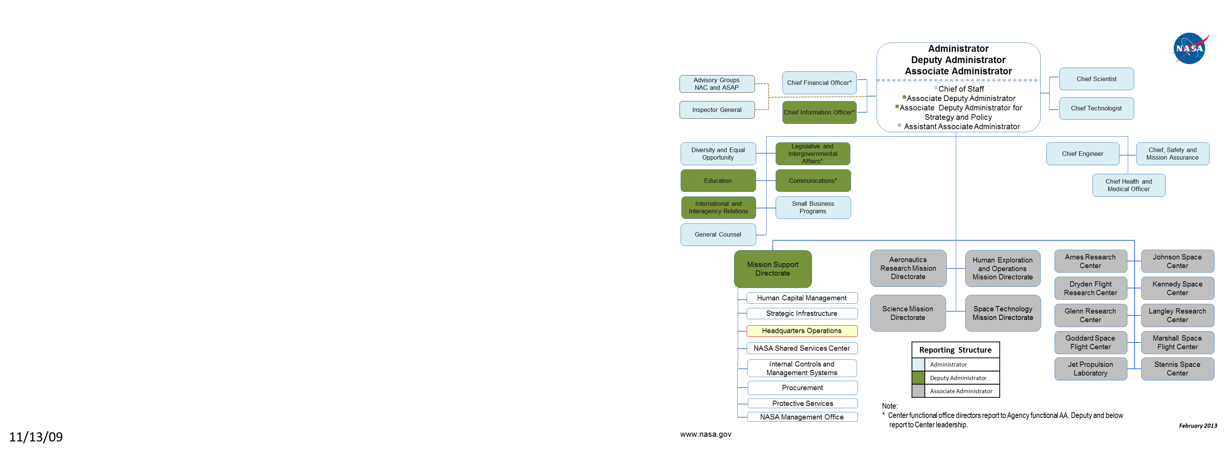
NASA Client| NASA Org Chart

Slide 10
NASA Client| ITCD Org Chart
Victor Thompson – CIO/Director
Dennis Groth - Deputy CIO/Deputy Director
Division Support
(VALADOR)
Ingrid Farrell
Contract Support
IT Financial Management Services
Debbi Martin-Edwards
Chief Technology Officer
Brady Decker – CTO
LM021
IT Operations Branch
Forood Boortalary—Acting
LM022
Customer Engagement Branch
Stanley Artis – Branch Chief
LM023
Technology Services & Solutions Branch
(Acting) Litesha Dennis – Branch Chief
LM024
IT Security Branch
(Acting) Marion Meissner – Branch Chief

Slide 11
NASA Client | Location and POC
Client location
NASA Headquarters
Address: 300 E Street, Washington, DC
Primary Client Contacts
Victor Thompson, Director & HQ CIO
Dennis Groth, Deputy Director & Deputy CIO
Liteshia Dennis, Contract Officer Representative, ITCD
Stanley Artis, Customer Services Branch Chief
Systems Operations Branch Chief
Marion Meissner, Security Services Branch Chief
Chris McCoy, App Development Manager, Technical Monitor
Sun Chan, IT Project Integration Manager, Technical Monitor
Forood Boortalary, NHCC Manager, Technical Monitor
Brady Decker, CTO & EA

Slide 12
NASA Client | NASA Centers and Facilities
In the course of supporting ITCD’s mission, we may interact with representatives from other NASA centers and facilities (listed below):
Ames Research Center (Mountain View, CA)
Armstrong Flight Research Center (Edwards,CA)
Glenn Research Center (Cleveland, OH)
Goddard Space Flight Center (Greenbelt, MD)
Jet Propulsion Laboratory (La Canada Flintridge, CA)
Johnson Space Center (Houston, TX)
Kennedy Space Center (Cape Canaveral, FL)
Langley Research Center (Hampton, VA)
Marshall Space Flight Center (Huntsville, AL)
Stennis Space Center (Hancock, MS)

Slide 13
Our Program: NASA HITSS

Slide 14
NASA HITSS Program | What is our Mission?
NASA Headquarters Information Technology Support Services (HITSS) program provides:
Integrated Information Technology, including integration with I3P (agency-wide infrastructure improvement program)
Senior level consultants to the Agency Office of the CIO for program management, financial planning, strategic planning, policy development and security
Systems Engineering and Operations
IT related management that assists ITCD in providing quality IT services to NASA Headquarter customers
Application Development services to meet HQ operation requirements

Slide 15
NASA HITSS Program |Essential Process Details
HITSS uses both Waterfall and Agile methods to support ITCD. Familiarize yourself with foundational materials that guide our work:
The Software Management Guide (SMG) describes the approved life cycle processes the HITSS team uses to develop, prototype, and deploy application services.
Templates and Standard Operating Procedures (SOPs) facilitate and support SMG compliance
The latest version of the SMG is available on the HITSS Contract Management Information Systems/Program Management/HITSS Deliverables/Software Management Guide and Templates sub-site and SOPR (https://merope.hq.nasa.gov/sopr/ws/hdmssopr/all/main/SearchForm)
Software Development Life Cycle (SDLC):
Service Request (SR) types
Class 1 – New service or changes to existing service; requires Configuration Control Board (CCB) approval for development (SR Review Team (SRRT)) and deployment (Operational Readiness Review (ORR))
Class 2 – Requests for product evaluations, white papers, Analysis of Alternatives (AoAs), archives, etc.
Problem with Schedule (PWS) – Bug fixes for custom applications

Slide 16
NASA HITSS Program |Operational Areas
PWS 2.0 Program Management Office (PMO) Support
Team located at the DMI Virginia Ave Office
Team Composition: All DMI Employees
PWS 3.0 Program Wide Services
Responsible for Delivery Management
Team located at DMI Virginia Ave Office and DMI Crystal City Office
Team Composition: DMI Employees and Subcontractors
PWS 4.0 User Support Services
Responsible for Support Services and End User Training
Team located at NASA HQ
Team Composition: Primarily Subcontractors
PWS 5.0 Application Development
Handles Multimedia, Application and Website Development
Team located at the DMI Crystal City Office
Team Composition: Mostly DMI Employees

Slide 17
NASA HITSS Program |Operational Areas
PWS 6.0 Operations (Data Center)
Team located at NASA HQ
Team Composition: All Subcontractors
PWS 7.0 Engineering
Team located at NASA HQ
Team Composition: All Subcontractors
PWS 8.0 Security Services
Team located at NASA HQ
Team Composition: All Subcontractors
CIO Consulting
Team located at NASA HQ
Team Composition: DMI Employees and Subcontractors

Slide 18
NASA HITSS Program | Who are our Partners?
In addition to DMI employees, the HITSS contract relies on subcontractors from a number of third party organizations including:
ADNET – Engineering/Operations & User Support Services
a.i. Solutions – Security Services
Clark & Parsia – Support Task Order, provide Agile Coaching/Expertise
Evoke – Financial Analysis
K Force – Application Development
Zivra – Application Development

Slide 19
Our NASA HITSS Team

Slide 20
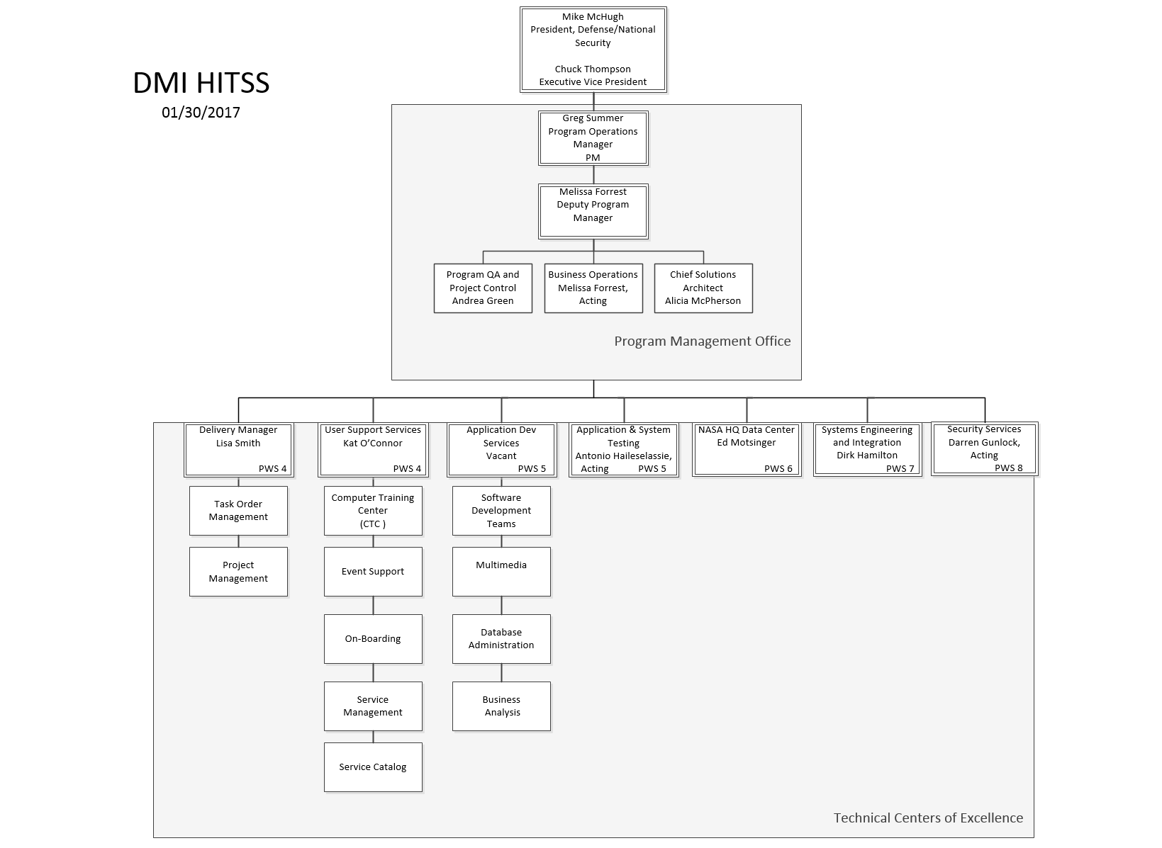
DMI HITSS Organization Chart

Slide 21
NASA HITSS Team| Management Team
Greg Summer, Program Manager
Desk Phone: 202-350-2118
Cell Phone: 703-593-4734
NASA Email: gregory.s.summer@nasa.gov
DMI Email: gsummer@dminc.com
Office Location: 400 Virginia Ave SW, Suite 200, Washington, DC
Melissa Forrest, Deputy Program Manager
Desk Phone: 202-350-2149
Cell Phone: 703-395-8424
NASA Email: Melissa.Forrest@nasa.gov
DMI Email: mforrest@dminc.com
Office Location: 400 Virginia Ave SW, Suite 200, Washington, DC

Slide 22
NASA HITSS Program| Logistics
Program Main Locations (where majority of team members reside):
DMI Office: 2451 Crystal Drive, 11th Floor, Crystal City
Metro: Crystal City (Yel/Bl line)
Parking: By meter (2hr max) or garage (2345 Crystal Drive)
DMI Office: 400 Virginia Ave, Suite 200, Washington, DC
Metro: L’Enfant Plaza Station (Or/Bl/Slv/Yel/Gr lines) & Federal Center (Or/Bl/Slv)
Parking: By meter (2hr max) or garage (Standard Parking, 400 Va Ave SW)
NASA HQ: 300 E Street, Washington, DC
Metro: L’Enfant Plaza Station (Or/Bl/Slv/Yel/Gr lines) & Federal Center (Or/Bl/Slv)
Parking: By meter (2hr max) or garage (Capitol View, 425 3rd St SW)

Slide 23
NASA HITSS Team| Our Principles
Walk the Talk: Follow Procedures and Share Knowledge
Peak Performance: Positive Attitude
Be proactive, not reactive
Follow up and follow through on action items and project deliverables on time
Become familiar with and use SOPs/processes; document and share needed updates
Share your knowledge from lessons learned with fellow teammates
Provide on-the-job training or mentorship to your peers if possible
Each member has a role in the team’s success – play your part
A can-do-attitude makes the impossible possible
Respond affirmatively to customer request but don’t make commitments – use lines of communication
Be eager and responsive when addressing urgent tasks or critical items
Align with the Team: Communicate
Strive for Excellence: Prepare to Win
Communication supports success!
Alert peers and leadership early when issues arise
Don’t hesitate to ask for help — use all lines of communication
Provide leadership with regular status updates
“Sundown Rule” — reply to emails and voicemails the same day (even to say you need more time)
Take ownership and commit to continuous learning and teaching
Focus on quality, accuracy and completeness
Take initiative to improve quality of deliverables
Turn lessons learned into action
Attention to detail makes the difference between good and great

Slide 24
NASA HITSS Team| Guidelines
Attendance | Coordinate with your team lead on your work hours. Communicate schedule changes to your team lead.
Work Absence | Request vacation leave as soon as possible — use Deltek to schedule time off. Contact your Team Lead when calling in sick — do not directly contact the applicable Government POC Setup an out-of-office message and voicemail greeting. Indicate when you will return, identify your backup, and say that the person should contact the direct supervisor if immediate assistance is needed. You must complete an occasional telework agreement to be eligible to work remotely in the event of illness or inclement weather. Fill out your timesheet before you leave for vacation.
Email | Use email to communicate effectively. Acknowledge, act, and follow up. Use it responsibly, and keep it informative and concise. Pick up the phone if the message requires more than three emails to address. HITSS employees are required to check NASA & DMI (if applicable) email on a twice a day basis (morning and afternoon), at minimum.
Timesheets | Timesheets must be filled in EVERY day! Contact your direct supervisor to get your login information for Deltek and charge numbers.
Dress Code | Location – Business Casual Attire Client meeting – Business Attire
Office Space | Routinely/periodically clean your work spaces – especially workstations shared by several individuals on different shifts. Please limit the number of personal items in work spaces in order to reflect a professional image to customers Be cautious and vigilant when handling sensitive client and/or DMI proprietary information — use designated shred boxes, burn bags etc. to dispose of sensitive documents and always follow government regulations for handling classified materials. Recycle paper/aluminum cans/glass and plastic bottles (but not any work materials, including notes) using recycling containers. Please clean up after yourself in the kitchen.
Telephone | Identify yourself when you answer the phone. Be courteous and polite. Respond with the appropriate level of urgency. Stay on mute during conference calls if you are not talking.
Training | All team members must complete required and individualized training plans. Basic curriculum courses include: Annual Information Security & Privacy Training, and Annual NASA HQ Security Awareness Training.
Status Reports | Produced monthly.

Slide 25
NASA HITSS Team| The Importance of Communication
The main lines of communication that will lead you to succeed are:
With your Peers
To troubleshoot problems
To provide advice and ideas for improvement
To offer feedback
With your Team Lead
To provide status updates
To ask for technical, management, or professional guidance
To manage client requests and communications
With our Client
Talk to your Team Lead about how to address and handle direct communications with the Client

Slide 26
NASA HITSS Team| What Are Our Expectations?
You can expect Management to:
Be interested and to care
Business should be handled in a professional manner
Push us all to be better, to innovate, and to collaborate
Drive growth every day
We Expect you to:
Be engaged and offer ideas
Be honest
Communicate
Care (about the Customer, Company, Employees, Quality)
Be open to new ideas
Drive growth every day

Slide 27
NASA HITSS Team| Policies
HITSS employees are required to follow both DMI and NASA policies and procedures.
NASA Policies and Procedural Requirements are published in a system called the NASA Online Directive Information System (NODIS). This system is only accessible by NASA users with credentials.
The DMI Quality Center for Excellence SharePoint site contains DMI templates, processes, and policies. You log in using your DMI credentials.
The HITSS SharePoint site contains forms, templates, and policies specific to the HITSS contract. You log in using your DMI credentials.
* Please contact your manager if you require access to items on HITSS SharePoint and do not have DMI credentials.

Slide 28
Resources You Can Use

Slide 29
NASA HITSS Team| Training Resources
The NASA HQ Computer Training Center provides comprehensive training solutions for NASA HQ users. CTC offers training options in support of HQ core-load computer applications (Lync, Outlook, Work, Excel, Office 2013, PowerPoint), new employee orientation and special projects
For questions or scheduling assistance, please contact the CTC Manager or CTC Training Coordinator at ctc@hq.nasa.gov or 202-358-1111.
Register for hands-on classroom workshops through SATERN - https://saterninfo.nasa.gov/ or schedule a virtual training through the CTC. Mandatory IT Security training must be completely through SATERN.
You can complete free online training through DMI via SkillPort - https://dmi-learning.skillport.com/skillportfe/login.action DMI employees are required to complete mandatory trainings on SkillPort within a month of their onboarding.

Slide 30
NASA HITSS Team| Meeting Room Requests
NASA HQ: You must be connected to the network via VPN and must have a NASA identity.
Use the Headquarters Conference Schedule System (HQCSS)
Use your NDC credentials to enter the system.
Hit “Create new” at the left of the menu.
Complete the form with your meeting specifications and select “search available rooms”.
Find the drop down that list the rooms available and select the room.
Click “submit” at the bottom of the form.
You will receive an automated e-mail letting you know the request has been submitted and another saying the request has been approved.
VA Ave Office:
All three (3) NASA HITSS VA Ave Office rooms are included in the NASA GAL.
All HITSS employees with a NASA email account can arrange meetings through their NASA outlook calendar. Search for conference rooms: HQ-CR-4.
Should you need assistance, contact Project Planning and Control (PP&C), ppc@hq.nasa.gov
Crystal City office:
The Crystal City Conference rooms are included in the DMI GAL.
ALL HITSS employees with a DMI email account can arrange meeting through their DMI outlook calendar.
Should you need assistance, contact Project Planning and Control (PP&C), ppc@hq.nasa.gov

Slide 31
NASA HITSS Team| Contract Distro Lists
Frequently Used HITSS Email Lists:
Hitss-400VaAve@hq.nasa.gov (all HITSS employees at VaAve)
Hitss2451@hq.nasa.gov (all HITSS employees at Crystal City)
Hitss-hq@hq.nasa.gov (all HITSS employees at NASA HQ)
Hitss-offsite@hq.nasa.gov (all HITSS employees that work remotely)
Hitss-subs@hq.nasa.gov (HITSS subcontractors)
Hitss-all@hq.nasa.gov (all HITSS employees)
Hitss-DMI@hq.nasa.gov (HITSS DMI employees)
DMIAccessControl@dminc.com (DMI Badge Access)

Slide 32
NASA HITSS Team| Closing
We are excited to have you as part of the DMI NASA HITSS Program. We’ve got a great team and have a bright future together. Please do not hesitate to ask for help while you are coming up to speed, or anytime while you are on this team. Let’s have fun and do great things together in support of a fantastic customer.

Slide 33
Success Stories – NASA HITSS

Slide 34

Spot the Station
Provides dawn & dusk International Space Station (ISS) flyover sighting information for 6,734 locations around the world, including every county seat in the United States.
Allows users to do a location lookup of ISS flyovers for the upcoming week, along with sharing to Facebook and Twitter
300,000 active users signed up for ISS sighting alerts by email or text.
3rd most popular website at NASA: http://spotthestation.nasa.gov

Slide 35
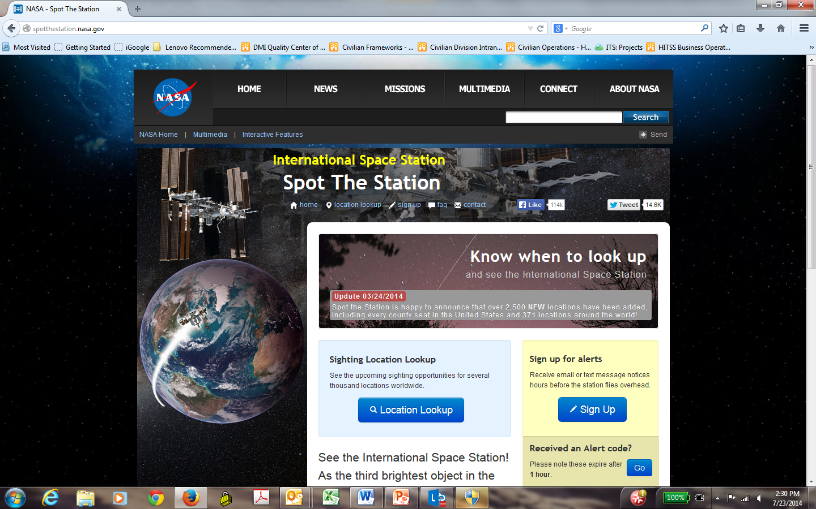
Spot the Station

Slide 36
Acronyms

Slide 37
NASA HITSS Program| Acronyms
AAIRS | Audit and Assurance Information Reporting System
ACES | Agency Consolidated End-User Services
ALR-DB | Audit Liaison Representative Database
AMR | Application Monthly Review
AoA | Analysis of Alternatives
API | Application Programming Interface
ARB | Architecture Review Board
ARMD | Aeronautics Research Mission Directorate
ASNA | ARMD Searchable NRA Awards
ATFI | Aerospace Technical Facility Inventory
ATP | Aeronautics Test Program
ATPIS | Aeronautics Test Program Internal Survey
AWCS | Agency-Wide Coding Structure
BASO-CMS | Business and Administrative System Office Content Management System
BAT | Business Analysis Tool
BESS | Budget Execution Support System
BMD | Budget Management Directorate
BSGSRA | Boy Scout and Girl Scout Recognition Application
BUMS | Business Management System
CCB | Configuration Control Board
CD | Compact Disc
CDB-GIS | Congressional Database Geographic Information System
CDR | Critical Design Review
CI | Continuous Integration
CIO | Chief Information Officer

Slide 38
NASA HITSS Program| Acronyms (cont’d)
CM | Configuration Management
CMP | Configuration Management Plan
CMS | Content Management System
CMTS | Career Management Tracking System
CONGDB | Congressional Database
CORTS | Congressional Online Request Tracking System
COTR | Contracting Officer’s Technical Representative
COTS | Commercial-off-the-shelf
CR | Change Request
CSDB | Customer Services Database
DBA | Database Administrator
DCMS | Discrimination Complaints Management System
DevOps | Developer Operations
DFMS | Direct Financial Management System
DR | Decommissioning Review
DRD | Data Requirements Definition
DS | Design Specification
DTRR | Developer Test Readiness Review
DVD | Digital Video Disc
EAI | Electronic Industries Association
EODMD | Equal Opportunity and Diversity Management Division
EOEB | Employee and Organizational Excellence
EOEB-TC | Employee Organizational Excellence Branch Training Calendar
ESD | Enterprise Service Desk
FAAD | Federal Assistance Award Data
FAD | Formulation Authorization Document
FASD | Facilities and Administrative Services Division
FERP | Facility Engineering Real Property
FHDS | Facilities Help Desk System

Slide 39
NASA HITSS Program| Acronyms (cont’d)
FMIC | Financial Management Internal Control
FOCUS | Financial On-Line Consolidated User System
FPPS | Federal Personnel Payroll System
FTE | Full Time Equivalent
GOS | Guest Operations System
GOTS | Government-off-the-shelf
GRIN | Great Images in NASA
GSTOPS | Guest Operations
HATS | Headquarters Action Tracking System
HATSACDB | Headquarters Action Tracking System Archive Database
HEC | Headquarters Exchange Council
HEOMD | Human Exploration Operations Mission Directorate
HITSS | Headquarters Information Technology Support Services
HPSS | Headquarters Personnel Security System
HQ | Headquarters
HQDMS | Headquarters Document Management System
HQeD | Headquarters Electronic Directory
HQEOPS | Headquarters Emergency Operations
HQITOUT | HQ IT Outage Calendar
HQLI-1 | Headquarters Line Item Database
HQSOPS | HQ Standard Operating Procedures
HQSOPSFF | HQ Standard Operations Procedures Service Feedback Form
HQTS | Headquarters Transformation Solution
HRMD | Human Resources Management Division
HRMIS | Human Resources Management Information System
HRPS | Human Resources and Personnel System
IBR | Integrated Baseline Review

Slide 40
NASA HITSS Program| Acronyms (cont’d)
ICD | Interface Control Document
ICET | Internal Control Evaluation Tool
ICONS | Inventions and Contributions System
iCTS | iComplaints Tracking System
IDAMS | IT Discovery and Mapping Service
IEEE | Institute of Electrical and Electronics Engineers
ISS-STS | International Space Station - Spot the Station
IT | Information Technology
ITA | Independent Technical Authority
ITAR | International Traffic in Arms Regulations
ITCD | Information Technology and Communications Division
ITSSECT | IT Sec Syslog & Event Correlation Tool
IWMS | ITCD Work Management System
IYA | NASA - International Year of Astronomy
JAD | Joint Application Development
KDP | Key Decision Point
LDP | Website - Leadership Development Program
LTS | Litigation Tracking System
MBPD | Master Buy Plan Database
MDAA | Mission Directorate Associate Administrator
MDash | Mission Dashboard
MDB | Milestone Database
MHBook | Management Handbook
MOTS | Modified-off-the shelf

Slide 41
NASA HITSS Program| Acronyms (cont’d)
MPR | Monthly Program Review
MPS | Master Planning System
MSD | Mission Support Directorate
MSDS | Media Services Database System
N/A | Not Applicable
NAC | NASA Advisory Council
NASA | National Aeronautics and Space Administration
NATS | NASA Audit Tracking System
NCTS | NASA Clearance Tracking System
NEST | NASA Exploration Survey Tool
NHQFB | NASA Headquarters FaceBook
NID | NASA Interim Directive
NIHE | NASA International Health Education
NLCW | Near Live Comet Watching
NMIS | NASA Management Information System
NODIS | NASA Online Directives Information System
NPD | NASA Procedural Directive
NPR | NASA Procedural Requirement
NRA | NASA Research Announcement
NRC ATS | National Research Council Activity Tracking System
NTV | NASA TV
NVDB | NASA Vendor Database
NVSS | NASA Vendor Survey System
O&M | Operations and Maintenance
OA&M | Operations Administration and Maintenance
OATS | OGC Action Tracking System

Slide 42
NASA HITSS Program| Acronyms (cont’d)
OCIO | Office of the Chief Information Officer
OCS | Office of Chief Scientist
OCT | Office of the Chief Technologist
OCTBESS | OCT Budget Execution Support System
ODIN | Outsourcing Desktop Initiative for NASA
OEM | Oracle Enterprise Manager
OEPM | Office of Education Performance Measurement
OGC | Office of the General Counsel
OIG | Office of the Inspector General
OIIR | Office of International and Interagency Relations
OLIA | The Office of Legislative and Intergovernmental Affairs
OLIS | OGC Legal Team Intranet Site
OPS | Office of Protective Services
ORR | Operational Readiness Review
OSI | Office of Strategic Infrastructure
PASNA | Privacy Act Statement Notification and Acknowledgment
PAVE | Project Announcement Visibility Effort
PCR | Project Completion Review
PCTR | Personnel Ceiling Transaction Report
PDJT | Printing and Design Job Tracking
PDR | Preliminary Design Review
PFSS | Parking and Fare Subsidy System
PIMS | Program Information Management System
PLDS | Photo Library Database System
PM | Project Management
PMP | Project Management Plan
PMRB | Project Management Review Board
POC | Point of Contact
POPS | People, Organizations, Projects, and Skills
PROJM | Project Manager

Slide 43
NASA HITSS Program| Acronyms (cont’d)
PTC | Project Tailoring Checklist
PWS | Problem with Schedule
QA | Quality Assurance
QAP | Quality Assurance Plan
QTRR | Quality Test Readiness Review
RAM | Rational Asset Manager
RAMS | Reasonable Accommodations Management System
RAPTOR | Research and Analysis Program Tracking of Resources
RMS | Requirements Management System
ROM | Rough Order of Magnitude
ROSA | Repository of Supported Applications
RRR | Release Readiness Review
RS | Requirements Specification
RSAID | Remote Secure Access Identification
RTCMD | Recording Tracking Classified Material Destruction
RWES | RSVP Web E-mail System
SCM | Software Configuration Management
SDD | System Design Document
SDLC | Software Development Lifecycle
SEDS | Special Events Database System
SEEL | Senior Employee Email List
SEF | Systems Engineering Facility
SIERA | System for International and Interagency External Relations Agreements
SMD | Science Mission Directorate
SMDLC | SMD Leave Calendar
SMG | Software Management Guide
SOP | Standard Operating Procedure
SPIAD | Science Pending International Agreements Database
SR | Service Request

Slide 44
NASA HITSS Program| Acronyms (cont’d)
SR&QA | Safety, Reliability and Quality Assurance
SRESS | Sponsored Research & Education Support Services
SRR | System Requirements Review
SRRT | Service Request Review Team
SSAC | Security Self Assessment Checklist
SSP | System Security Plan
STACR | Subversion/Trac Application Code Repository
SWCal | ScienceWorks Calendar
SWLDB | Software Library Database
SYNM | Send Your Name to Mars
TCWD | Take Your Child to Work Day
TDD | Test Driven Development
TGIR | Turning Goals into Reality
TO | Task Order
TRR | Test Readiness Review
UAT | User Acceptance Testing
UC | User Concurrence
UI | User Interface
UML | Unified Modeling Language
UOG | User and Operations Guide
UPATSW | Unit Price Agreement Tracking System Web
UX | User Experience
VDD | Version Description Document
VFDS | Video File Database System
VITS | Video Teleconferencing Service
WDPS | Workforce Diversity Profile System
WIMS | Workforce Information Management System

Slide 45
Thank you and Welcome Aboard!

